Slide 1

Meeting 2-3-2022
Rosa Maessen

Slide 2
Progress this week
Project Proposal
Working on dummy code
09-10-2020

Slide 3
Project Proposal
Research Question
Research question:
Can skill mutation result in better performance when doing robot-to-robot learning?
09-10-2020

Slide 4
Project Proposal
Research Question
Research question:
Can skill mutation result in better performance when doing robot-to-robot learning?
Sub-questions:
How can the performance of a robot be defined?
How does the skill of a robot mutate during robot-to-robot learning?
How does the skill of different types of robots mutates during robot to robot learning
09-10-2020

Slide 5
Project Proposal
Research Question
Research question:
Can skill mutation result in better performance when doing robot-to-robot learning?
Sub-questions:
How can the performance of a robot be defined?
How does the skill of a robot mutate during robot-to-robot learning?
How does the skill of different types of robots mutates during robot to robot learning
What enables the mutation of the robots’ skills?
09-10-2020

Slide 6
Project Proposal
Method
Requirements
Task definition (probably sawing task), one task for both experiments
Not many other collaborative periodic tasks available
Rises the question: is it useful to do a periodic task then?
Performance metric
Depending on the task
For sawing: time till sawed through a block
09-10-2020

Slide 7
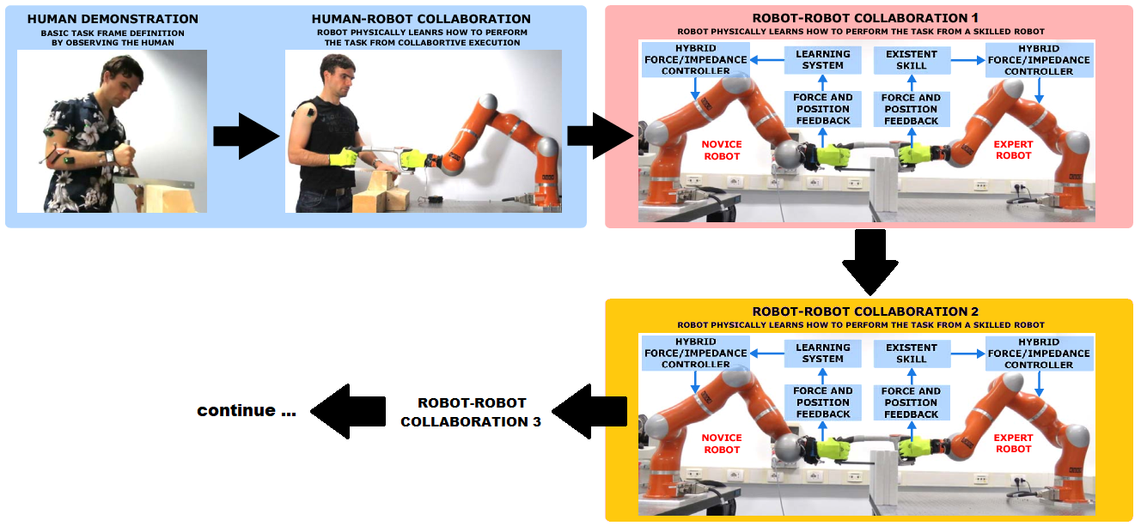
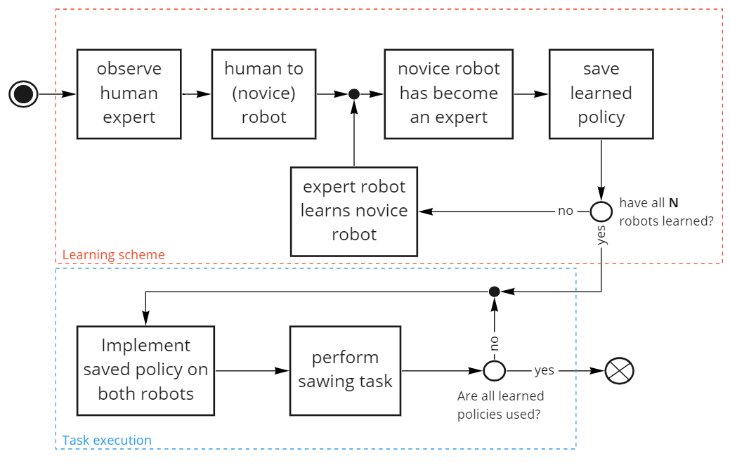
Experiment 1
09-10-2020

Slide 8
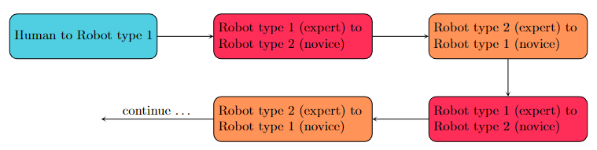
Experiment 2
Multiple conditions
Type of robots
Environments
Difficulty task
Initial demonstrations (e.g., another person)
Learning times (shorter/longer)
09-10-2020

Slide 9
Planning
Project Propsal
Setting up the experiments
Executing experiments
Write report
Analysis of data
Defining experiments
Writing the code
Simulation
Real-world
Simulation
Real-world

Slide 10
Method
What do I need?
Starting code

Slide 11
Dummy Code
PMDP code
Encoding and reproducing signal
https://gitlab.com/tpetric/pDMP_C/-/blob/master/pDMPstructure.cpp
https://gitlab.com/dmp-codes-collection/dmp-periodic
AFS Code
Calculation of frequency and phase
https://gitlab.com/tpetric/AFS_C/-/blob/master/AFSstructure.cpp

Slide 12
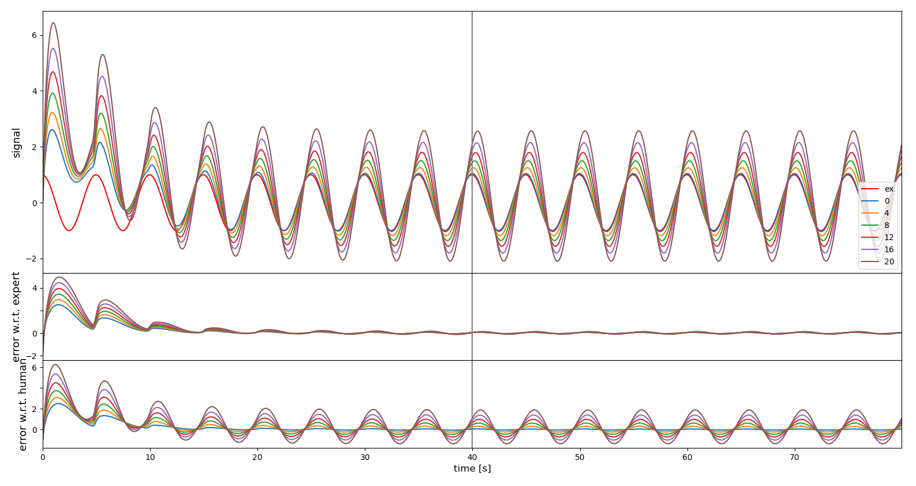
Dummy Code
Periodic MDP Chain

Slide 13
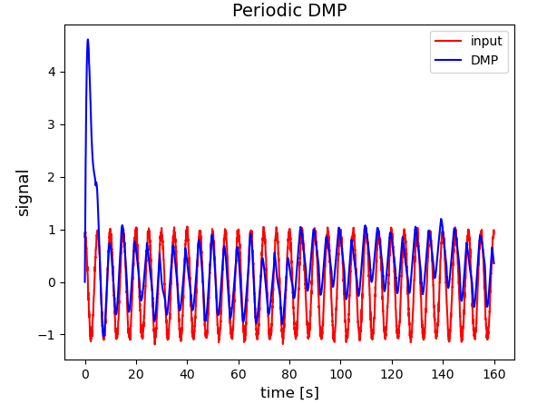
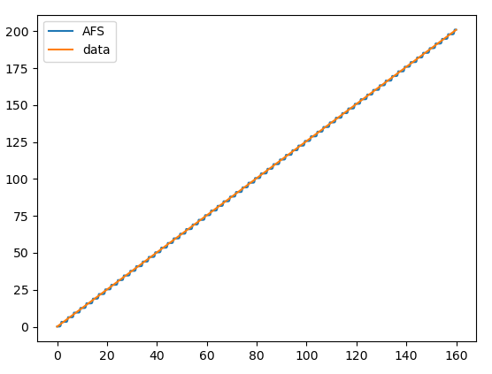
Dummy Code
Adaptive Phase Oscillator based on Adaptive Fourier Series

